Slide 1


Before the Talk Begins…
Get your mobile devices ready!
  Load up a song-identification app:
SoundHound:
Shazam:
or

Slide 2
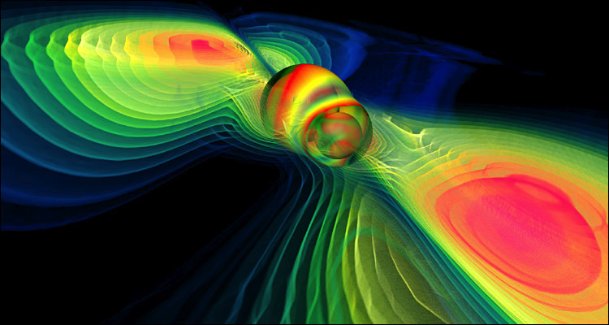
Hearing the Still, Small Voice: STEM+AET Features of Gravitational Wave Detection
Dr. Scott H. Hawley
Associate Professor of Physics
Belmont University
Image: Werner Benger, ZIB/AEI/ZoneIB/CCT/AHM. Used with permission.

Slide 3
Outline
Demo: Song Identification
What is the LIGO Discovery?
How Was This Discovery Made?
Why Should We Be Excited?

Slide 4

Demo: Song Identification
SoundHound:
Shazam:
Song
Noise + Song
Noise + Quieter Song (-6dB)
Noise + Even Quieter Song (-12dB)
Noise + Quietest Song (-18dB)

Slide 5
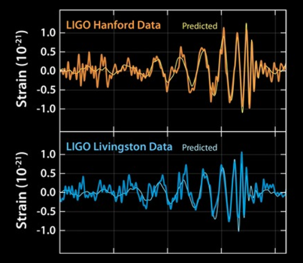
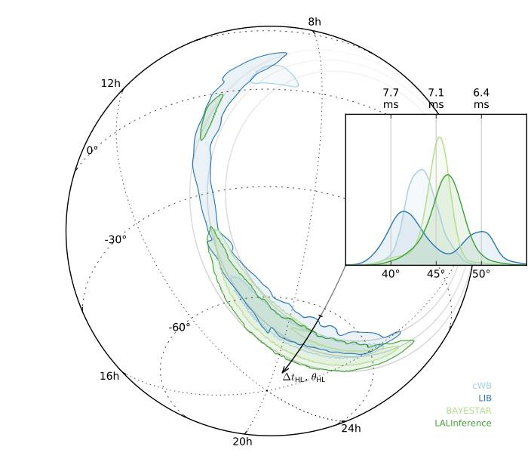
What is the LIGO Discovery?
"Up until now, we have been deaf to the universe. Today, we are able to hear gravitational waves for the first time.”
-Dr. Dave Reitze, LIGO Executive Director
September 14, 2015: Exactly 100 Years After Einstein’s Prediction!

Slide 6
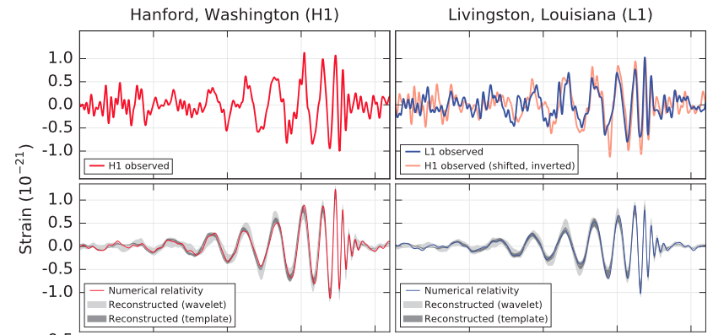
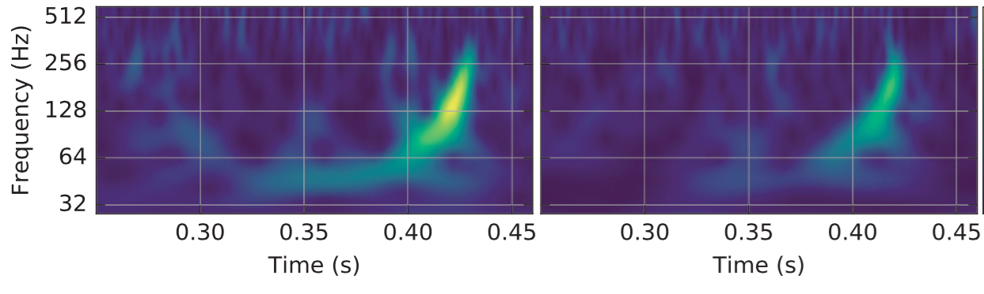
What is the LIGO Discovery? p2

Slide 7
Discovery p.3
“It matches the waveform predicted by general relativity for the inspiral and merger of a pair of black holes and the ringdown of the resulting single black hole.”
Source is about 410 Mpc away (1.3 billion light years)
Initial BH masses: ~36 and ~29 solar masses, final BH ~62M⊙, with ~3M⊙ radiated in gravitational waves.
“These observations demonstrate the existence of binary stellar-mass black hole systems.”
“This is the first direct detection of gravitational waves and the first observation of a binary black hole merger.”
BOOM!

Slide 8
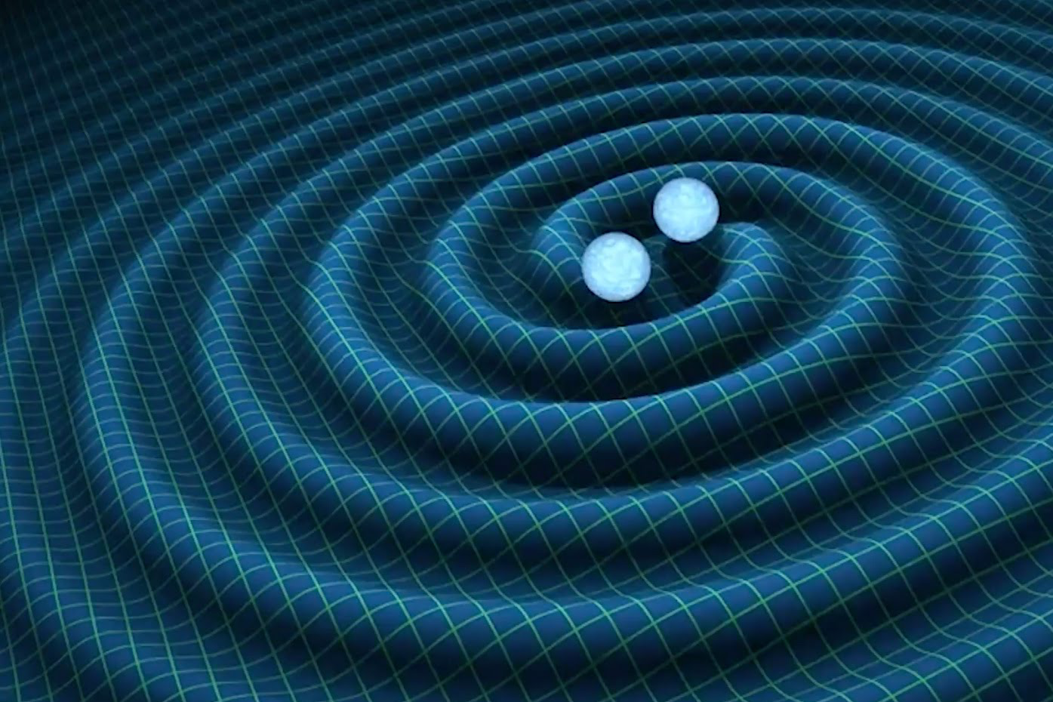
What Are Gravity Waves?
Well, for starters…
What is Gravity?

Slide 9
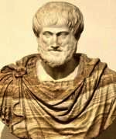
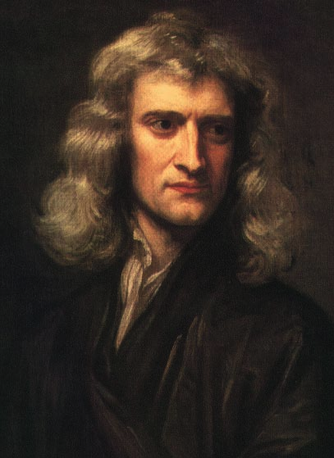
What is Gravity?
Aristotle: An object falls to the ground because it wants to be near the center of the universe, which is the center of the Earth.
Newton: An object falls to the ground because it experiences a “force” of attraction between itself and the earth. This force is universal, acting between any two objects. The strength of the force is given by the following formula:
  Allowed us to describe motion of planets, and put a man on the moon!

Slide 10
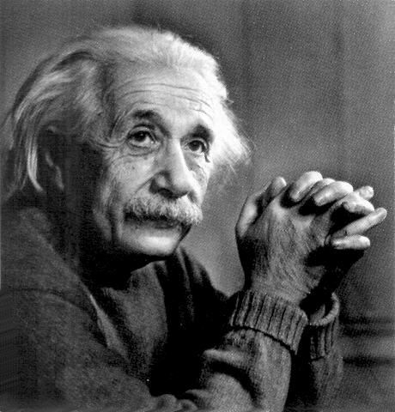
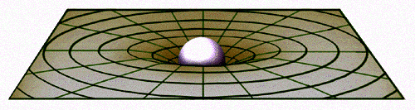
What is Gravity? p.2
Einstein, 1915: An object falls because it is moving on the straightest possible path in a curved, four-dimensional spacetime geometry. The curvature is due to the mass-energy of the earth.
Einstein’s model of gravity can be made mathematically precise in his theory of General Relativity (GR)...

Slide 11
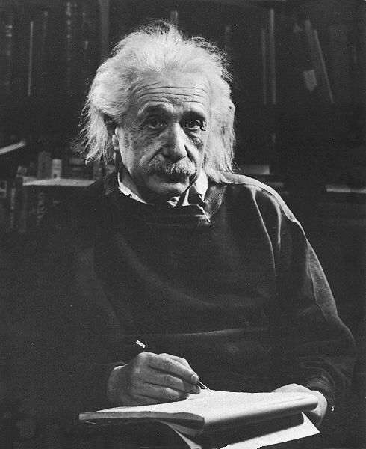
General Relativity (GR)
In GR, gravity is not a force, rather it is a manifestation of spacetime curvature.
In general, the curvature G_{μν} and mass-energy T_{μν} are related by
G_{μν} = 8π T_{μν}
GR allowed us to have GPS, understand orbit of Mercury, and predict amazing new things...

Slide 12
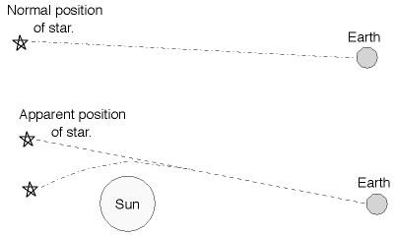
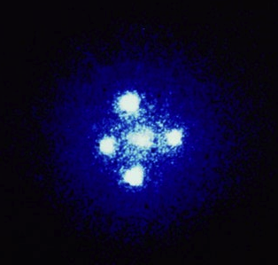
A Few Predictions of GR
Gravitational lensing - bending of light
Black Holes
Gravitational Waves
Gravitational Lens G2237 + 0305, HST

Slide 13
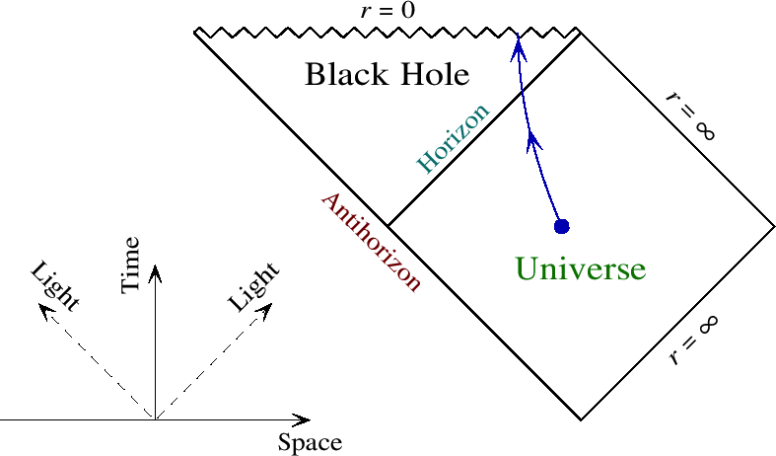
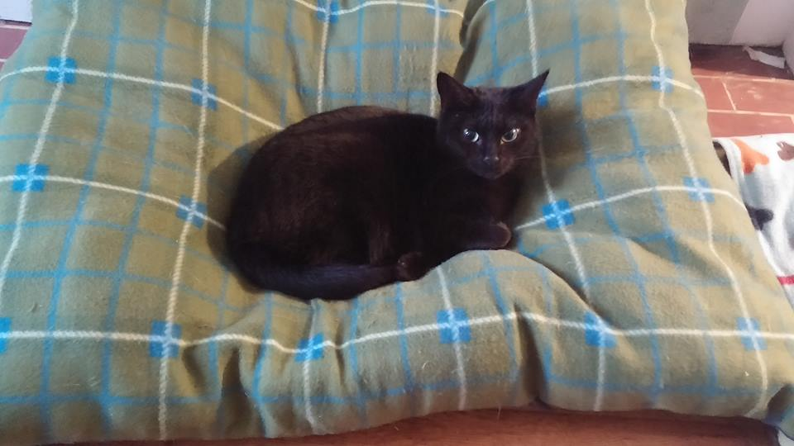
What is a Black Hole?
A black hole is a region of space(/time) where the geometry is so distorted, nothing can escape -- not even light!
Formed either by collapsing stars, mergers of galaxies, or in the early universe
Photo: Lisa Katerina

Slide 14
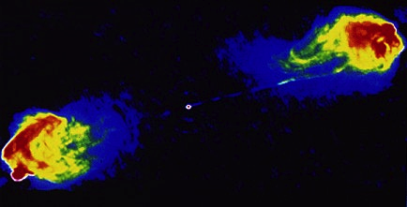
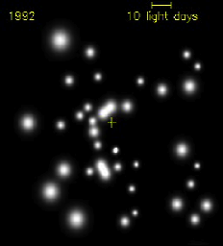
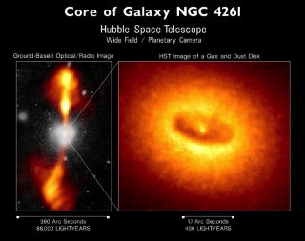
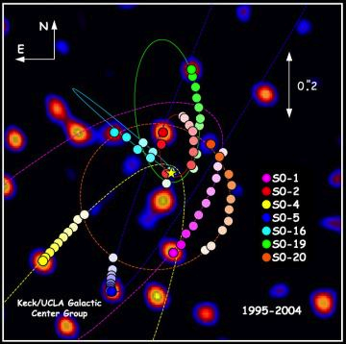
Astrophysical Black Holes
Something is making stars move really fast at the center of the Milky Way (Sag A*)...
...and driving radio jets in Cygnus

Slide 15
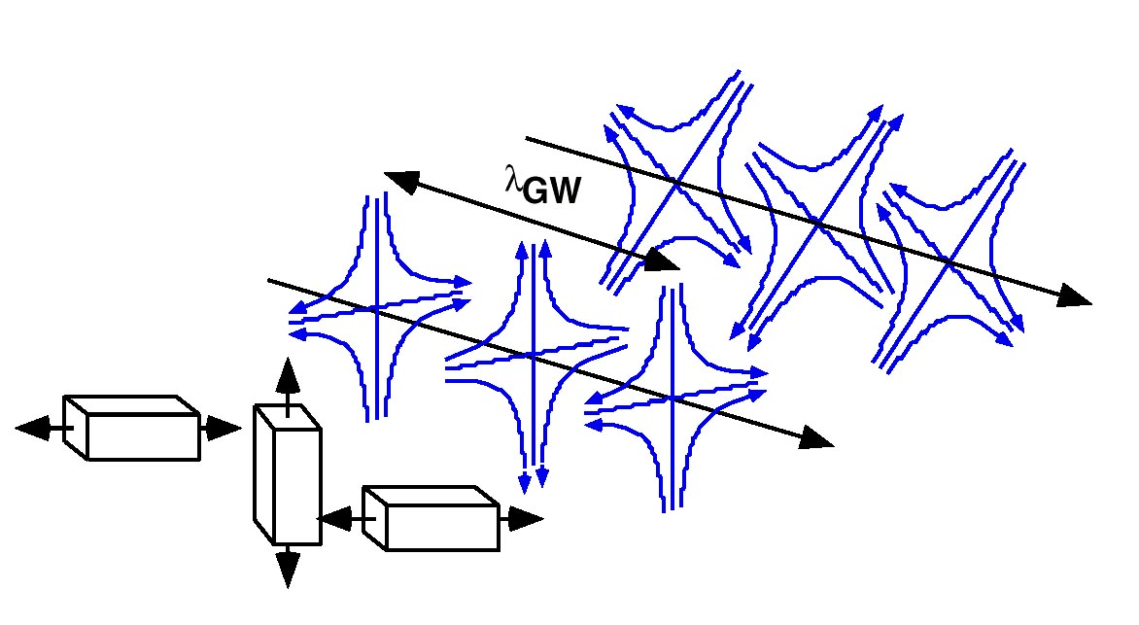
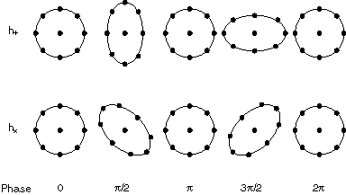
What are Gravitational Waves?
Gravitational waves are ripples in spacetime which propagate at the speed of light
Similar to electromagnetic waves, except GW have two distinct polarizations, “plus” and “cross”:

Slide 16
How are GW Generated?
Gravitational Waves are generated by just about any accelerating massive object
Strongest sources of GW: dense, heavy masses going around each other very fast
  binary black holes!
  binary neutron stars
  BH-NS binaries

Slide 17
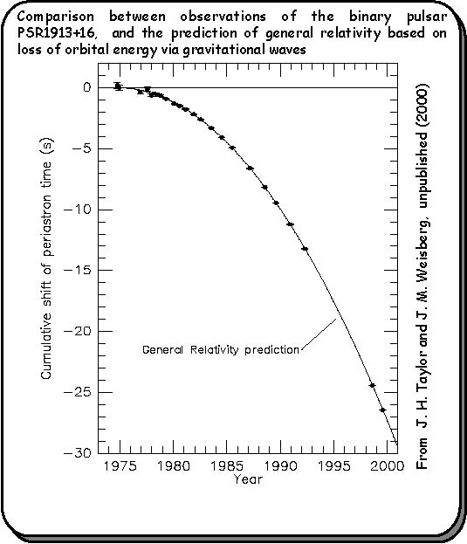
Prior Evidence of Gravity Waves
Indirect Detection: Binary Pulsar PSR1913+16
17 / sec
•
•
period ~ 8 hr

Slide 18
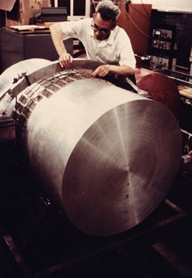
What is LIGO?
Gravitational Waves are very weak, and only produce effects of order 10⁻²¹.
  In other words, these detectors must be the most sensitive instruments ever designed by man!
Two ways people have tried:
  Resonant Bar Detectors
  Interferometric Detectors...
Photo of Joseph Weber, courtesy
AIP Emilio Segrè Visual Archives

Slide 19
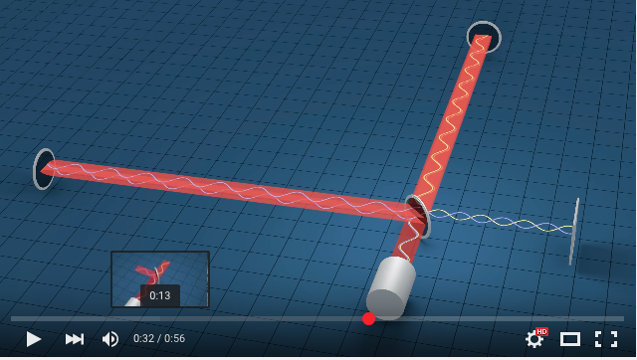
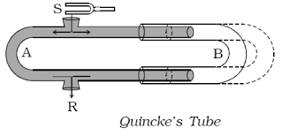
How Does An Interferometer Work?
YouTube: LIGO Interferometer Video
Acoustical Analogue: Quincke’s Tube
Web Audio Demo

Slide 20
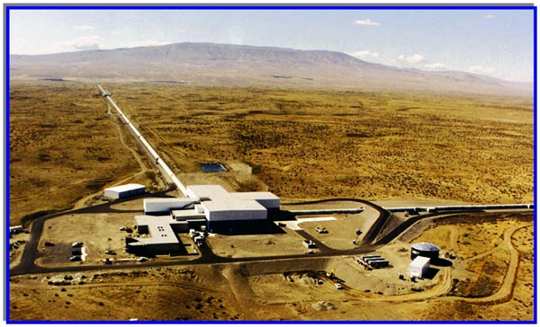
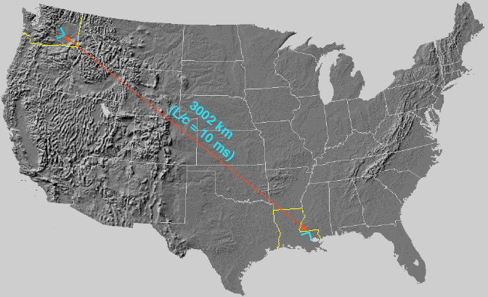
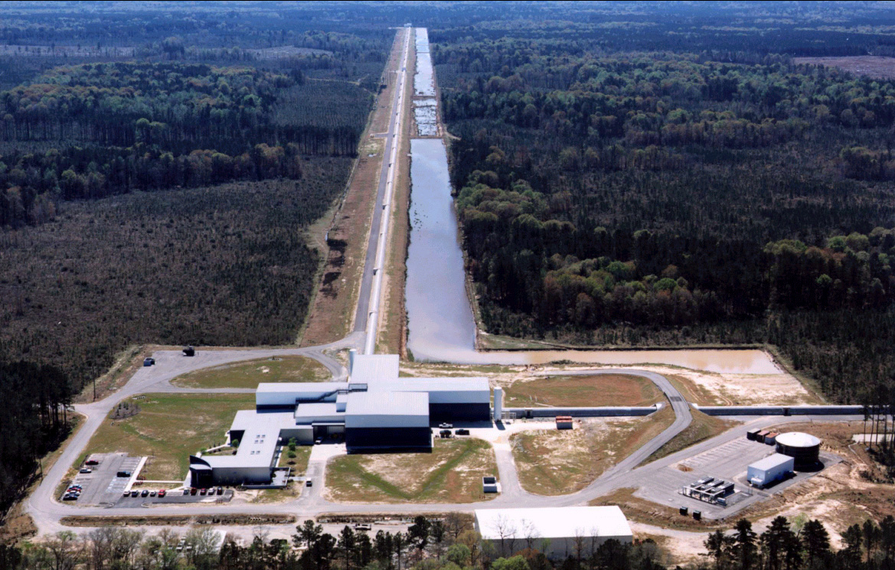
What is LIGO? cont’d
Two detectors at different places on Earth
Hanford , WA
Livingston, LA
Images: Barry Barish / LIGO

Slide 21
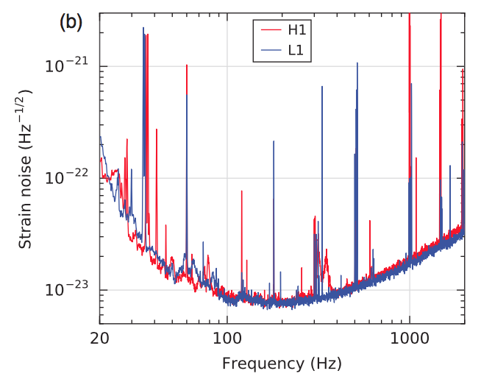
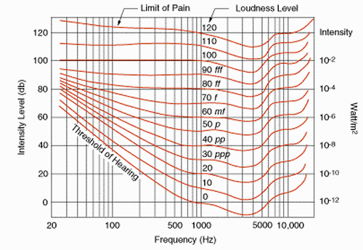
How Sensitive is LIGO?
LIGO
Human Auditory System

Slide 22
What is Involved in Detecting GW?
Source Detection, Identification & Localization:
  Music Business:
    Mobile Apps: Shazam, SoundHound
    Licensing / Royalties: YouTube, ASCAP, SESAC, BMI
  Health Sciences: Audiology
  Public Safety: Gunshot detection
Signal Processing (Math/Physics/Audio Eng.):
  Waveform processing & analysis (“Science DAW”)
  Matched Filter of Input Stream vs. Template(s)
    Spectral Processing / Fourier Transforms
    Temporal Processing / Cross-Correlation
  Data representation & storage

Slide 23
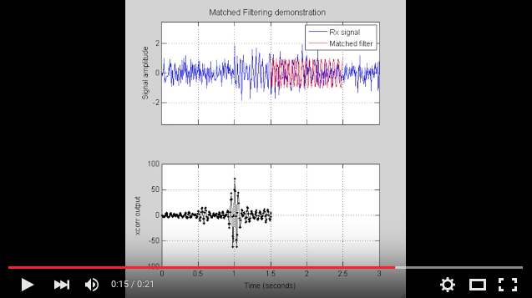
Matched Filter Demo
YouTube video: cross-correlation
Video: Michelle Weirathmueller

Slide 24
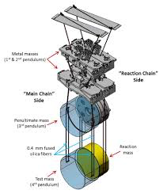
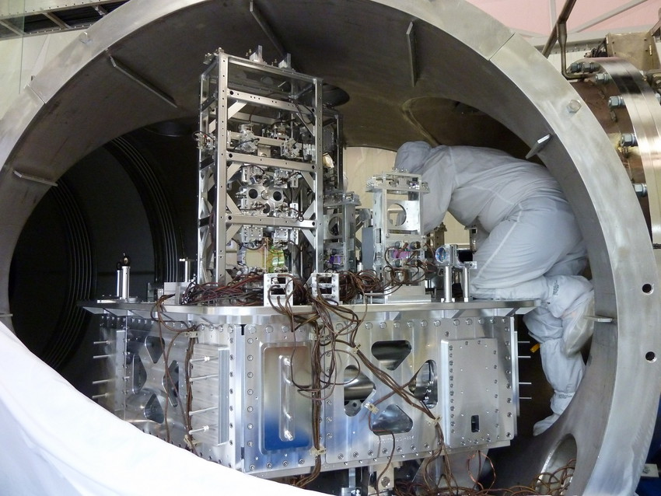
What’s Involved in Detecting GW? p.2
Isolation From Noise:
  Cryogenics, Vacuums
  Mechanical Engineering:
    Quadruple pendulum system, + active seismic isolation
Demo: Series of Simple Harmonic Oscillators / Helmholtz resonators / Parametric Eqs:

Slide 25
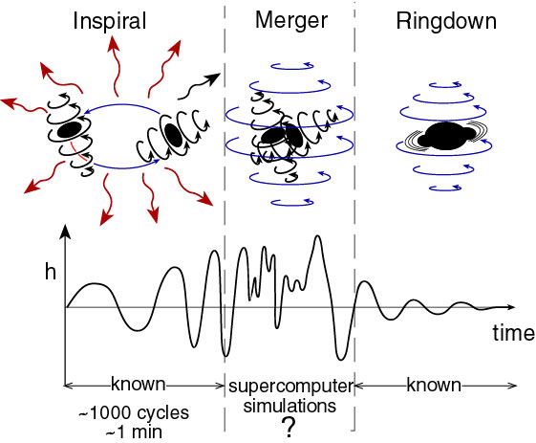
What’s Involved in Detecting GW? p.3
Providing a Template Signal:
  Math, Theoretical Physics:
    Differential Geometry, Nonlinear Dynamics, Numerical Analysis
  Computer Science:
    Computer Modeling/Simulation
    High Performance (Super-)Computing
    Big Data
    Visualization
Image: Barry Barish / LIGO

Slide 26
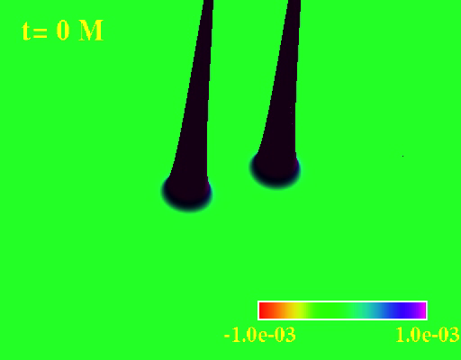
Supercomputer Simulations…
F. Pretorius

Slide 27
How Do We Know the Discovery is Right?
Same signal at both detectors
Signal is completely uncorrelated with sensor data from any other part of detectors’ operation (e.g., from seismic data)
“False alarm rate estimated to be less than 1 event per 203,000 years, equivalent to a significance greater than 5.1σ”
(Agrees with numerical simulations)
…and months of checking, plus peer review & acceptance

Slide 28
Why Should We Be Excited?
Complaints:
  “It’s not new physics” / “We already knew gravity waves exist”
  “GW are so weak…No relevance for life on Earth”
Responses:
  GWs from black hole mergers give us insight into strong-field General Relativity: never been tested
  Also, GW detection will open a new “window” of Astronomy, through which new discoveries await! “GWs penetrate more”
  Relevant because Astronomy informs our understanding of our place in the universe.
  Excited because it’s like the moon landing! ;-)

Slide 29
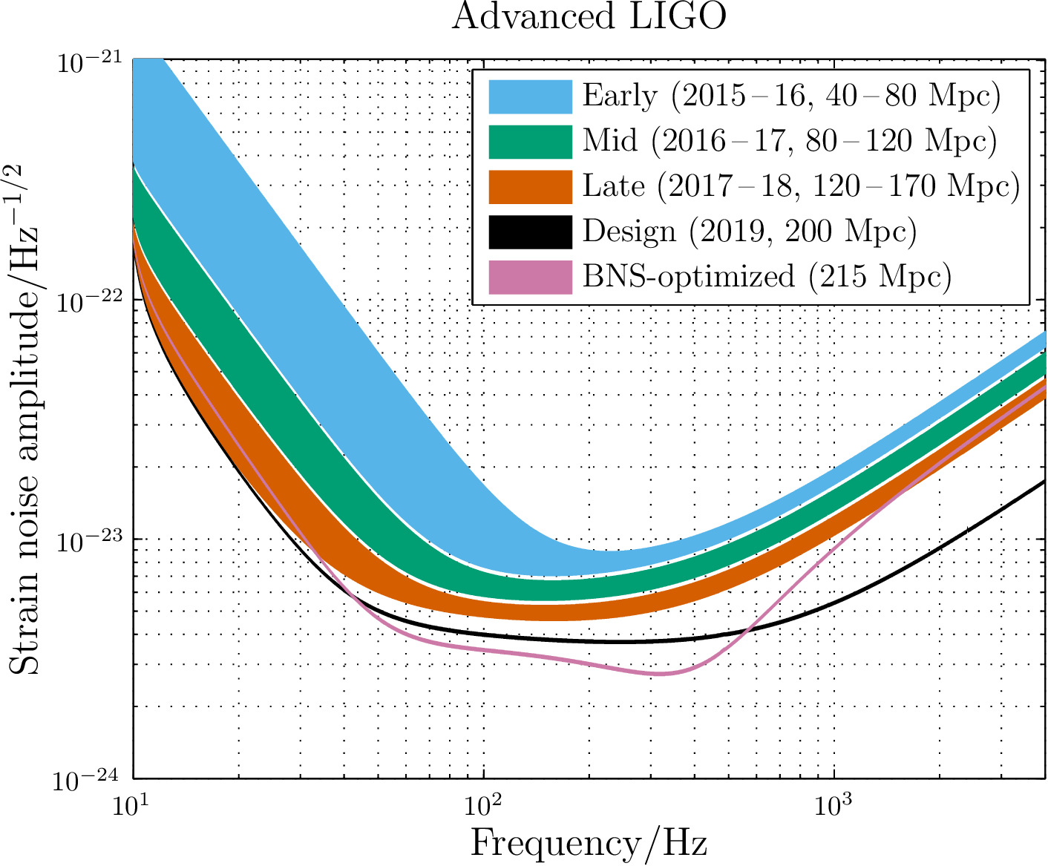
What Does The Future Hold?
Better Detection!
  Improved sensitivity
    Will allow for more detections (“seeing farther”)
  Detectors in Italy, Germany, Japan, India
    Will improve source localization
  Detector in Space!
New Astronomy!...

Slide 30
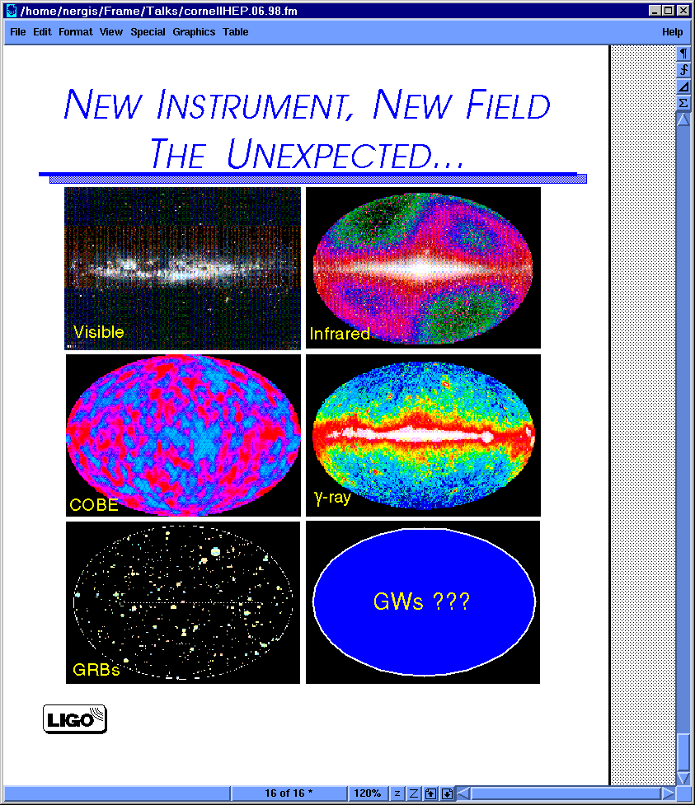
Future: GW Astronomy!

Slide 31
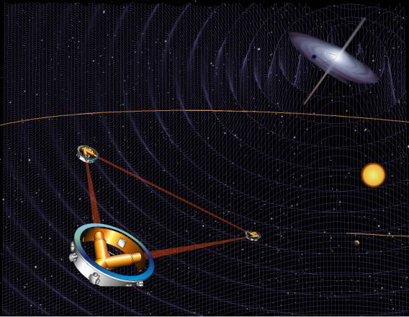
Future: LISA
LISA (an ESA project) will be an interferometric detector consisting of a network of three satellites, orbiting the sun

Slide 32
What Does the LIGO Discovery Say About How Science is Done?
“Big Science” collaboration
  “Founded in 1997, the LSC is currently made up of more than 1000 scientists from dozens of institutions and 15 countries worldwide.” -- ligo.org/about
  Largest NSF-funded project ever
  Sustained commitment over 25 years (ahem, NASA?)
Integrity of researchers: No announcement until…
  Results were checked, re-checked...
  Paper(s) submitted, peer-reviewed and accepted
  Paper(s) published! (Feb 12, 2016).
Effort, commitment, & community pay off!

Slide 33

How Can I Get Involved?
More work in modeling, detection and data analysis needed to detect GW => careers in GW astronomy!
Learn calculus, physics and/or computer science
Run Einstein@Home / BOINC screensaver
Join Society of Physics Students (SPS)!
Apps: Come to Belmont Summer Camp
Summer Research Experience for Undergraduates
  LSU, Florida, Caltech, Hanford, others…
Come to Belmont!
Tell your politicians to support basic science research (e.g. NSF & NASA)!
1st SPS Meeting:
March 30, 10AM WAC 4098

Slide 34
Links & References
http://www.ligo.org:
  http://ligo.org/teachers.php
    Activities, Labs
  http://ligo.org/students.php
    Games!
http://www.einsteinathome.org (analyze data)
http://SoundsOfSpacetime.org (audio apps)
http://www.black-holes.org (public ed.)
Several images used in this talk came from Dr. Barry Barish, LIGO/Caltech

Slide 35
Black Holes at Belmont
(In case anyone asks:)
“Initial Data Solver” computer code
  Simulations need good initial data for spinning BH binaries; our ID will be in demand!
    Need to get bugs in parallel mesh refinement ironed out

Slide 36
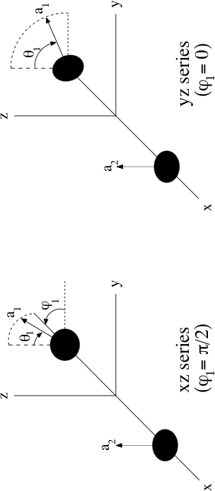
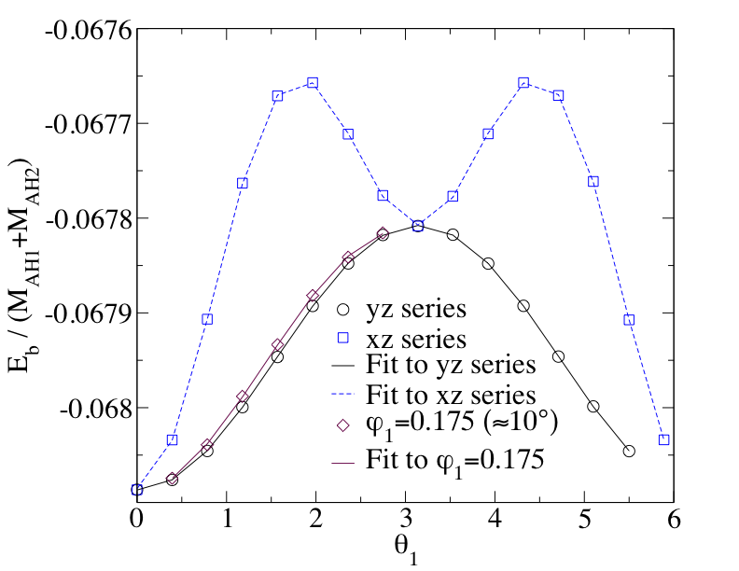
Can Use ID Solver for Science!
(In case anyone asks:)
Study of binary BH spin-spin interaction:
From “Spin Dependence in Computational Black Hole Data,” SH, M. J. Vitalo, & R. ,. Matzner” gr-qc/0604100. Aug2006.
Expected:
Plus addt’l “mass quadrupole moment” effect:

